Slide 1
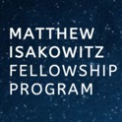

Inspiring the Next Generation of Commercial Spaceflight Leaders
[University] Info Session
[Month] [date], 2019

Slide 2
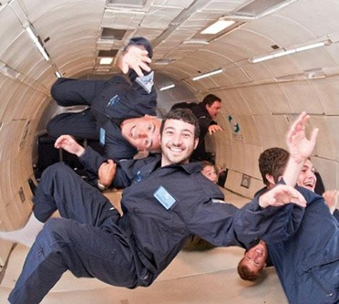
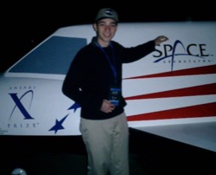
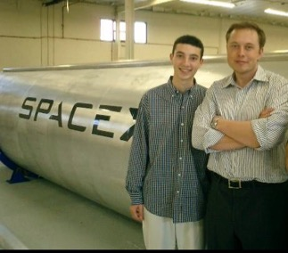
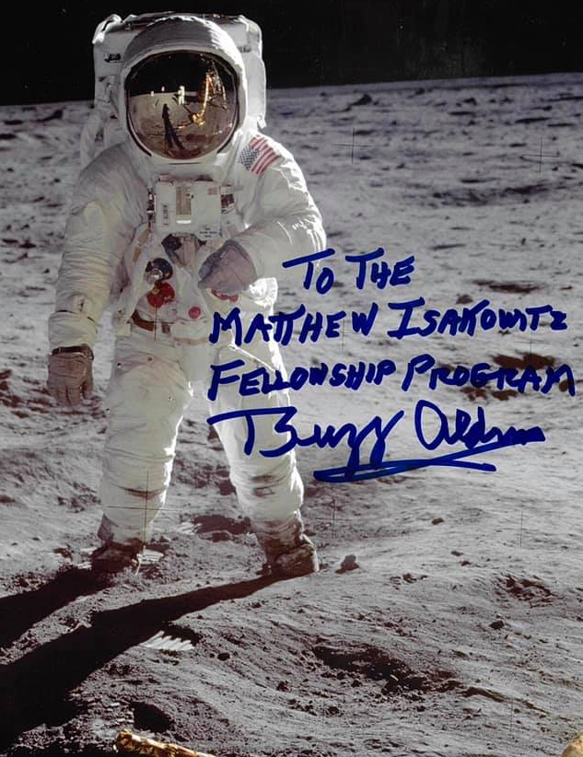
Who Inspired the Program?
The Program was created in memory of Matthew Isakowitz (1987–2017)
— an engineer, entrepreneur, and extraordinary individual whose
passion for commercial space exploration led to great strides in
the industry and inspired all who knew him.
The Program seeks to instill that same enthusiasm into the next generation of commercial spaceflight leaders by providing impactful career training to those who embody Matthew's drive for exploring our universe to help better humankind.

Slide 3

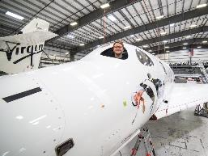
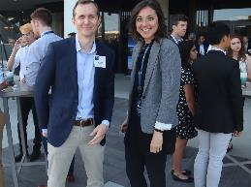
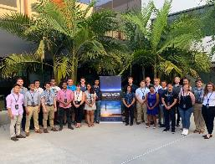
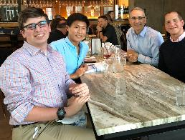
What is the Matthew Isakowitz Fellowship Program?
The Fellowship is designed to inspire and grow
the next generation of young men and women to be the
future innovators, entrepreneurs, and leaders of the commercial space industry.
Internship
Mentorship
Summit
Networking
Open to current college juniors, seniors, and graduate students
Notes:
➢ INTERNSHIP-- Paid summer internship at leading commercial space companies
➢ MENTORSHIP-- Paired with an experienced and notable space industry leader plus a Fellow alum as a Buddy.
➢ SUMMIT-- Bring together Fellows at end of summer to network with one another to learn more about the latest developments in commercial spaceflight from top leaders
➢ NETWORK-- Fellows are among an elite group of alumni to continue to network with this program, Fellow peers, mentors, and future Fellows, on the path to becoming space icons.

Slide 4
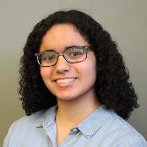
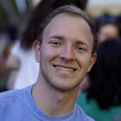

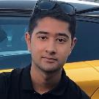
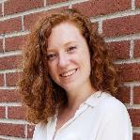
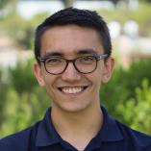
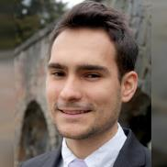
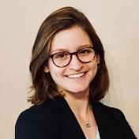
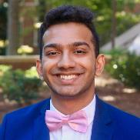
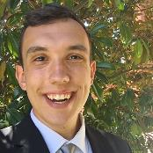
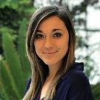
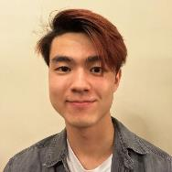
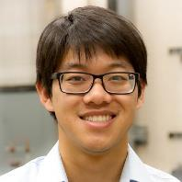
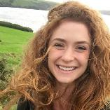
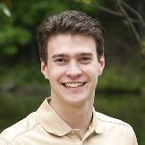
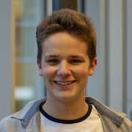
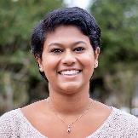
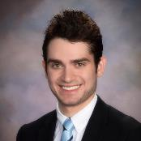
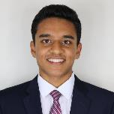
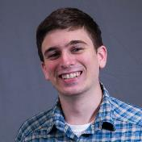
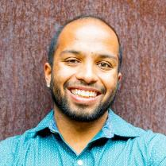
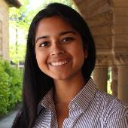
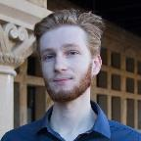

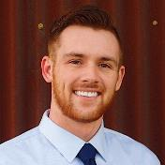
2019 Fellows
Notes:
2019 Fellows Info
6 PhD, 7 Masters
Previous work: 13 NASA, (7 JPL, 4 Langley), 8 SpaceX
7 rocketry clubs
PASSION

Slide 5




















Host Companies

Slide 6
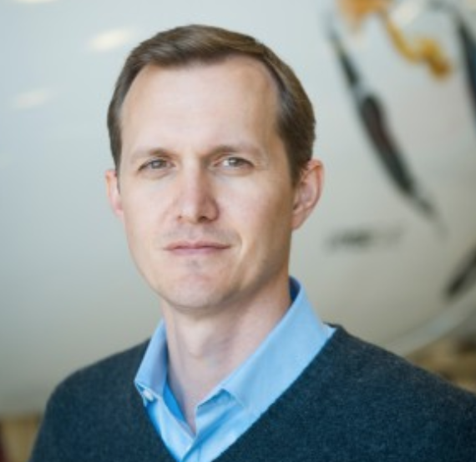
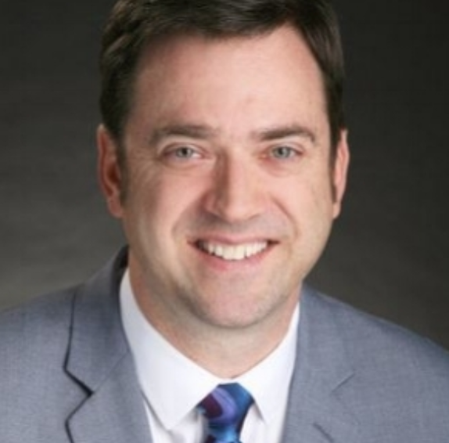
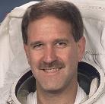
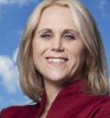
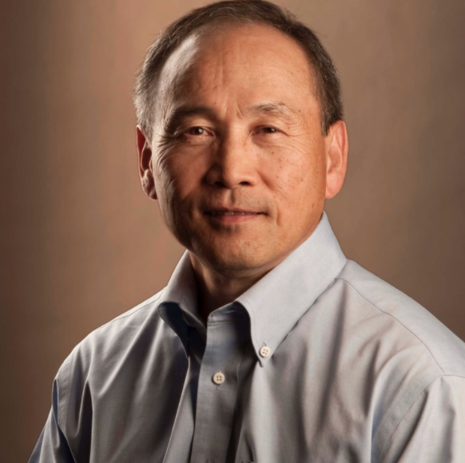
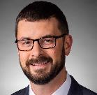
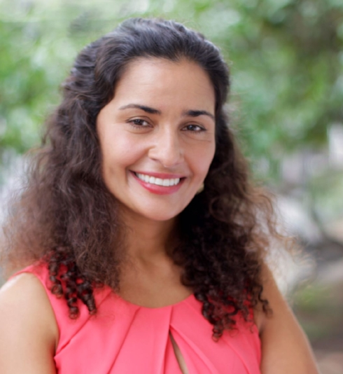
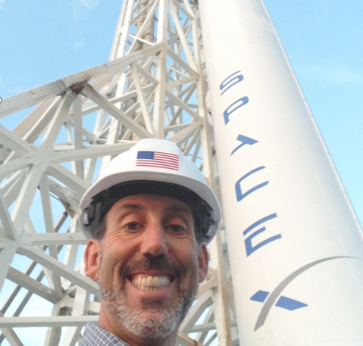
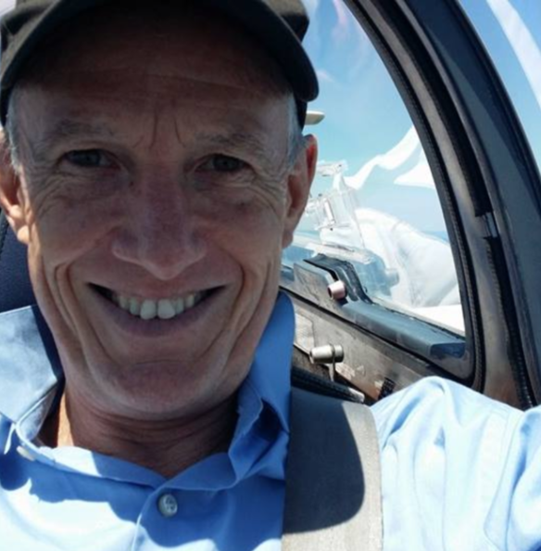
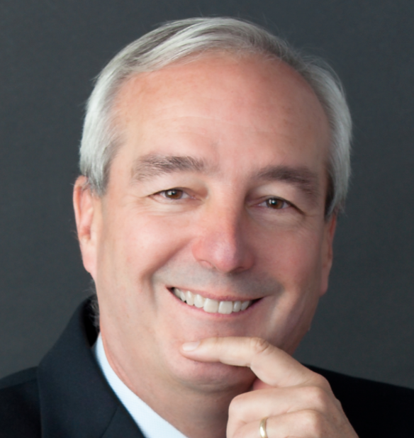
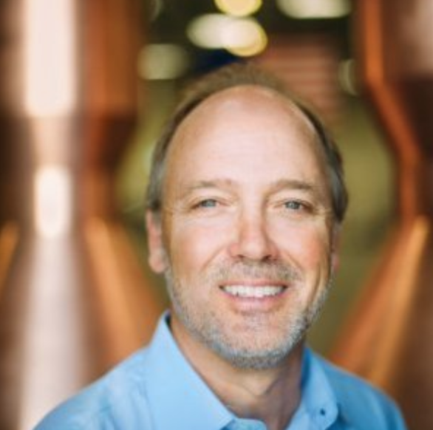
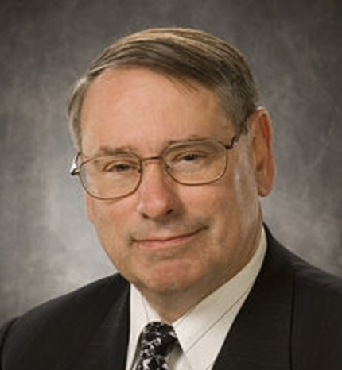
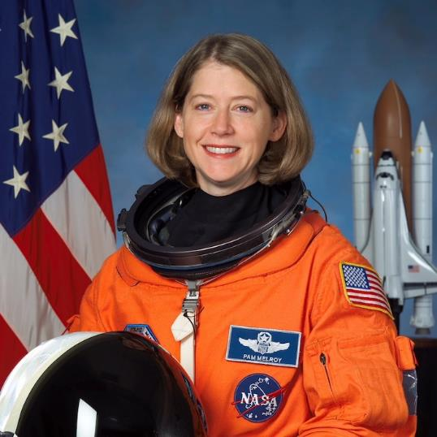
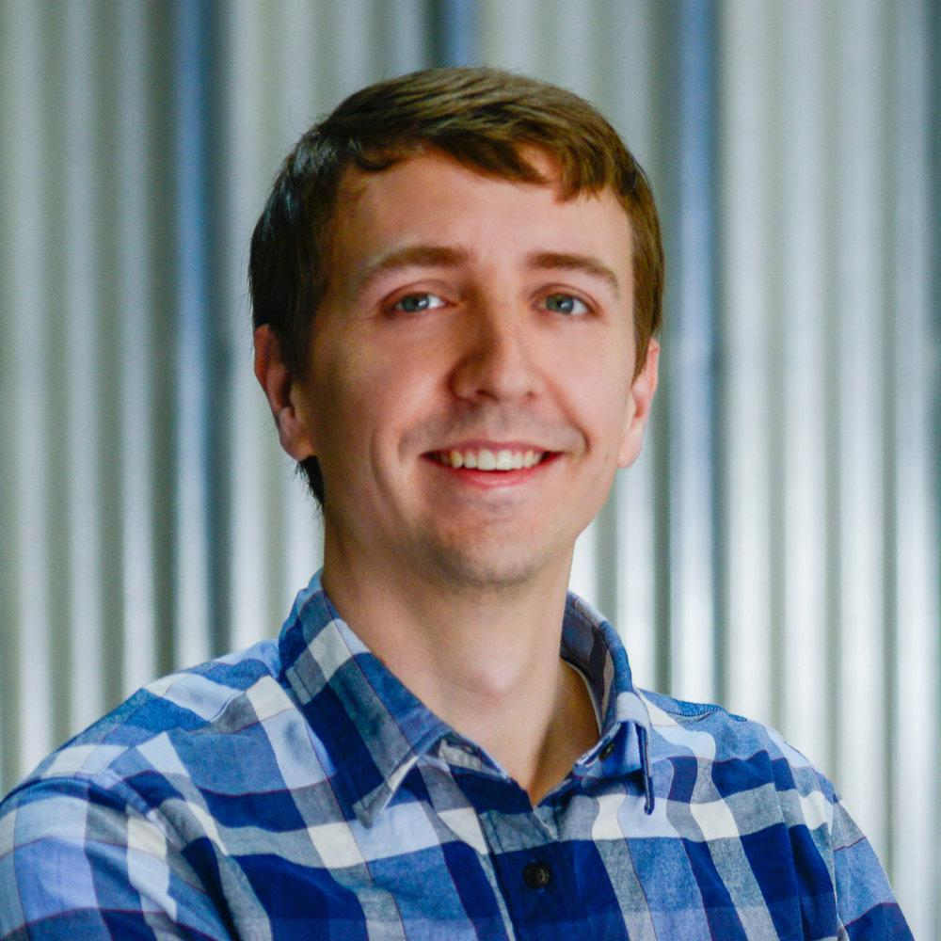
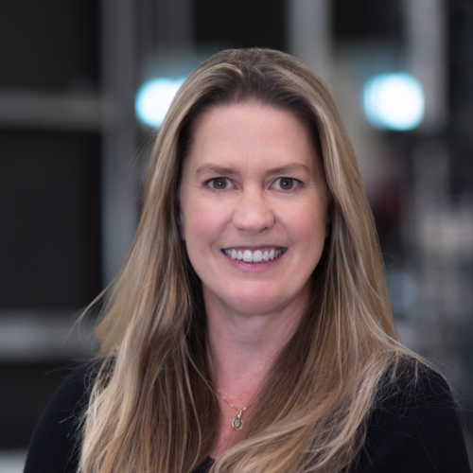
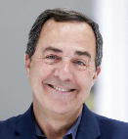
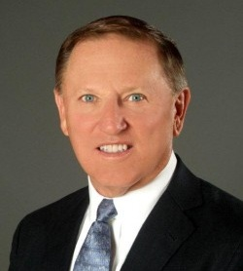
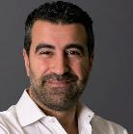







Executive Mentors
George Whitesides
Virgin Galactic and TSC
CEO
Brett Alexander
Blue Origin
VP
John Grunsfeld
Astronaut
Suzi McBride
Iridium
COO
Barry Matsumori
BridgeComm
CEO
Joe Landon
Lockheed Martin
VP
Anita Sengupta
ASX
VP
Lee Rosen
SpaceX
VP
Alan Weston LTA
CEO
Ray Rothrock
Venture Capitalist
Tim Buzza
Relativity Space
Distinguished Engineer
Pete Worden
Breakthrough Prize
Chairman
Pam Melroy
Astronaut
John Gedmark
Astranis
Co-Founder/CEO
Mandy Vaughn
VOX Space
President
Mark Sirangelo
Entrepreneur
Stu Witt
Space Exec
Bulent Altan
Global Space Ventures
Co-Founder
Bobby Braun
CU-Boulder
Dean of Engineering
Kacy Gerst DARPA
Chief of Commercial Strategy
Phil Ingle
Morgan Stanley
Managing Director
Chris Moran
Lockheed Ventures
Executive Director
Randy Villahermosa
Aerospace
Executive Director, Innovation
Jeffrey Manber
Nanoracks
CEO
Karina Drees
Mojave Spaceport
CEO

Slide 7


Summit
“Very impressed with the extraordinary individuals selected for the Matthew Isakowitz Fellowship Program. It’s a quality program with an inspirational legacy—connecting fellows in the exciting field of commercial spaceflight.”
- Buzz Aldrin, Apollo 11 Astronaut
Elon Musk
Buzz Aldrin

Slide 8



Networking
Notes:
Lifelong networking with Fellows, Executives and MIFP Alumni

Slide 9
























2018 Fellow Alums-
Where are They Now?
Eva Abramson
ABL Space Systems
Previously: UCLA
Sam Albert
Colorado-Boulder (MS)
Previously: Purdue (MS)
Yash Chandramouli
Stanford (MS)
Previously: Georgia Tech (BS)
Shayna Hume
Colorado-Boulder (PhD) Previously: U of Miami (BS)
Dylan Dickstein
UCLA (PhD)
Sydney Dolan
MIT (PhD)
Previously: Purdue (MS)
Max Goldberg
Strike Force
and Wisconsin-Madison (BS)
Henry Ha
Princeton (BS)
Padraig Lysandrou
Colorado-Boulder (MS)
Previously: Cornell (BS)
Josh Etkind
Tufts (MS)
Leon Kim
JPL
and Columbia (BS)
Brian Hardy
Illinois (MS)
Calvin Lin
Stanford (MS)
Previously: Stanford (MS)
Dylan Cohen
House Comm.-Science, Space, Tech.
Previously: MIT (MS)
Hailee Hettrick
MIT (PhD) Previously: MIT (MS)
Axel Garcia Burgos
MIT (PhD)
Golda Nguyen
MIT (MS)
Previously: Georgia Tech (BS)
Todd Sheerin
Aerospace Corp
Previously: MIT (PhD)
Alex St. Clair
Colorado-Boulder (MS)
Jeremy Stroming
MIT (MS)
Previously MIT (BS)
Ian Vorbach
U Penn (MBA)
Previously Stanford (MS)
Adam Zachar
Accion Systems
Previously: U Penn (MS)
Chloe Downs
Georgia Tech (PhD)
Daniel Dyck
Blue Origin
Previously: Embry Riddle (BS)
Notes:
Most alum went to grad school/advance degrees – some got jobs (Accion, ABL, House Committee on Science, Space and Technology, BlueOrigin)

Slide 10
In the Words of a 2019 MIFP Fellow...
“This was one of the most memorable experiences of my life. Ever since I read "How to Build a Spaceship", I knew I wanted to get into commercial space. Little did I know that book was written because of the work done by so many people involved with this program, especially Matthew.
My entrance into the commercial space industry came full circle with this Fellowship. This Fellowship left an indelible mark with me and I will forever be grateful to MIFP and the work done to honor Matthew.”

Slide 11





Key Dates
Interviews
APPLICATION OPEN
Start Internship
SEP 2019
NOV 2019
DEC 2019
JAN 2020
JUNE 2020
JULY 2020
Host Company and Mentor Match
MIFP Summit
APPLICATION DUE
Notes:
Application
Resume
References
Essays (2019- 2020 Not released yet)
(800 words) Why are you excited about commercial space and your current future role in it, and why are you a strong candidate for this Fellowship?
(350 words) Please describe the type of company and internship work assignment you would prefer and why?
(350 words) Choice:
What technology will most revolutionize commercial space in the next 10 years and why?
You are on the User Advisory Group for the National Space Council. You are asked to participate in one committee out of the following: exploration & discovery, national security, economic development/industrial base, technology & innovation, education & outreach, or space policy & international engagements. What committee would you choose and what policy issue would you propose the committee address?
You have just stepped into an elevator with an investor and lucky you, you have an idea for a commercial space startup. What is your startup idea, and what elevator pitch would you give them to convince them to invest in your business?
PASSION !!!

Slide 12




For more information visit: MatthewIsakowitzFellowship.org

Slide 13

Ad Astra
MatthewIsakowitzFellowship.org

